Slide 1
Predicting Win Probability
Alvin Hampton

Slide 2
The Goal
Our goal is to estimate the probability that a team will win at any point in a game, based on the current game state such as score, time remaining, and field position
Use play-by-play game state data to produce an accurate win probability prediction
Compare machine learning models for probabilistic prediction
Since we are predicting probabilities, not just outcomes, we need evaluation metrics that measure both classification performance and probability quality

Slide 3
The Metrics
Accuracy : Above 80% is considered strong
ROC-AUC : (.5 = baseline) Above .85 is considered strong
Brier Score : (.25 = basline) < .13 is strong
Log Loss : (~.69 = baseline) < .4 is considered strong
Because we are predicting win probabilities, no single metric is sufficient. We use multiple metrics to evaluate both classification performance and the quality of probability estimates. A strong model should perform well across all metrics, not just one and our goal is to produce a model that does

Slide 4
The Metrics (cont.)
Accuracy:
measures how often the model correctly predicts whether a team will win or lose.
gives us a simple baseline measure of correctness, but it does not evaluate the quality of probability estimates
Ignores how confident the prediction is. A prediction of 0.51 and 0.99 are treated the same, even though they represent very different levels of certainty
ROC-AUC:
ROC-AUC measures how well the model distinguishes between winning and losing situations by evaluating how consistently it assigns higher probabilities to wins than to losses.
Ex: if I were to pick a random winning play and a random losing play, how often does the model give the win a higher probability?

Slide 5
The Metrics (cont.)
Brier Score:
Mean squared error of predicted probabilities
The Brier Score measures how close predicted probabilities are to the actual outcomes, using squared error.
It directly measures probability accuracy and validates real-world reliability
Log Loss:
Measures how close the predicted probability is to the actual outcome (0 or 1). It heavily penalizes 'confident' but wrong predictions.
In win probability modeling, we care not just about being right, but about being correctly confident. Log loss captures this.

Slide 6
The Data
Scope: 8 complete seasons of College Football (2017–2019, 2021–2025). Over 10,000 games
Scale: ~1.72 million individual play events.
Breadth: Covers all FBS-level programs, including non-conference and bowl games.
Dimensionality: 362 columns including deep text descriptions, team metadata, and coordinate-level EPA/PPA metrics.
Non-Action Events: ’noise’, containing thousands of administrative rows (coin tosses, timeouts, end-of-period markers) that have no 'pre-snap' value but impact game state logic.

Slide 7
The Data (challenges)
The Issue: Raw datasets often contain '1st and Goal’ plays where the distance to a first down is listed as 10 yards, even if the team is on the 2-yard line. This contradiction (requiring 10 yards for a first down with only 2 yards left on the field) created significant noise in field position value.
The Solution:
We applied a distance cap via the PySpark pipeline.
Whenever the Goal_To_Go flag is True, we force the distance to equal the yards_to_goal.
This ensures the model correctly learns that scoring a touchdown is the way to convert in a goal-to-go situation, improving our Red Zone win probability accuracy.

Slide 8
The Data (challenges)
The Issue: Standard play-by-play data typically tracks TimeSecsRem within each half (1800 seconds to 0). This causes a mathematical 'break' at halftime, making it difficult for models to distinguish between a lead in the 2nd quarter versus the 4th quarter.
The Solution: We implemented a Game Clock normalization.
If period is 3 or 4, we maintain the linear countdown from 3600 seconds.
This provides the model with a continuous urgency feature, ensuring it understands that a 7-point deficit with 120 seconds left in the game is more critical than 120 seconds left in the half.

Slide 9
The Data (challenges)
Beyond the primary issues of clock resets and Red Zone distance errors, the ingestion process revealed several other noise factors
Duplicate Event Sequencing: In roughly 0.5% of games, the game_play_number would skip or duplicate. We had to implement a secondary sort using period and TimeSecsRem to ensure chronological integrity.
Garbage 'Play Text': We found several hundred rows where the play_text was simply “ BREAK " or "null", yet these rows contained valid score and time data. These had to be manually re-classified or dropped if they lacked a play_type.
Score Differential Spikes: Some raw rows recorded a score change before the touchdown play was actually logged. We resolved this by calculating pos_score_diff based on the starting score of the play rather than the end-of-play result.
Overtime Logic: Overtime periods (Period 5+) follow entirely different rules (no clock, specific yardage). We opted to filter these out of the standard Win Probability model to prevent them from skewing the 'Time Remaining' weights in the 4th quarter.

Slide 10
PySpark Utilization
Processing 1.7 million rows with 360+ columns required significant memory. Standard Pandas operations would often trigger Out-Of-Memory (OOM) errors
PySpark’s distributed architecture lazily evaluates data, allowing it to process millions of rows across a cluster or partitioned local memory.
PySpark :
Used distributed window functions to sort plays chronologically by game, period, and clock time.
Imputing values like remaining timeouts required forward-filling data based on both game_id and half. PySpark’s Window functions were efficient at these conditional grouped operations
Calculated new features like rolling averages for EPA and Yards over the previous 5 plays. Because Spark is distributed, it handled these partitions (grouped by game) in parallel.
We used Spark to perform the ‘trimming’ by dropping hundreds of raw text columns and metadata

Slide 11
FEATURE SET (24 FEATURES)
Base Game State & Priors (11 Features)
We started by aligning the raw play-by-play data to the perspective of the Possession Team (the team with the ball):
down, distance, yards_to_goal, TimeSecsRem : (represents raw field position and clock)
pos_score_diff : (Score differential in relation to who has possession)
pos_team_timeouts_rem_before, def_pos_team_timeouts_rem_before : (Timeouts)
is_home_team : (Binary flag for home-field advantage)
pos_team_elo, def_pos_team_elo : (Pre-game team strength ratings)
pos_team_spread : (Vegas spread aligned to the possessing team)

Slide 12
FEATURE SET (24 FEATURES)
Drive Fatigue & Rolling Momentum (5 Features)
We sorted the data chronologically and used PySpark window functions to look at the past to help predict the future:
drive_yards_so_far: Cumulative yards gained on the current drive.
drive_success_rate: The percentage of successful plays on the current drive.
drive_time_elapsed: How long the offense has been on the field this drive (Fatigue).
pos_rolling_EPA_last_5: The Expected Points Added over the team's last 5 plays.
pos_rolling_yards_last_5: The average yards gained over the team's last 5 plays.

Slide 13
FEATURE SET (24 FEATURES)
Interaction Terms (5 Features) We multiplied features together to explicitly teach the models (especially Linear model) about compound situations:
inter_score_x_time: Score differential multiplied by the fraction of time elapsed. (Being up by 7 points matters a lot more in the 4th quarter than the 1st).
inter_spread_x_time: Spread multiplied by time remaining. (Pre-game expectations matter less as the game goes on).
inter_down_x_distance: Down multiplied by distance. (3rd & 10 is much harder than 1st & 10).
inter_elo_diff: Possession ELO minus Defense ELO.
inter_timeout_diff: Possession timeouts minus Defense timeouts.

Slide 14
FEATURE SET (24 FEATURES)
Polynomial Terms (3 Features)
We squared certain features to account for non-linear relationships (e.g., the difference between the 50-yard line and 40-yard line is small, but the difference between the 15-yard line and 5-yard line is massive):
poly_TimeSecsRem_sq: Time remaining squared.
poly_yards_to_goal_sq: Yards to goal squared.
poly_score_diff_sq: Score differential squared (preserving the negative/positive sign via Sign-preserved Squaring).
Target Variable
pos_team_win: We looked ahead to the last play of the game, determined the winner, and mapped 1.0 if the possession team eventually won, and 0.0 if they lost.

Slide 15
The Features
These features were chosen because they directly influence win probability and allow the model to learn how game situations evolve over time.
The Base State features: Down, Distance, Score Diff, and TimeRemaining
Importance: These establish the baseline probability. A 1st & 10 at the 50-yard line has a mathematically measurable expected point value that serves as a foundation.
The Interactions Terms
Raw features are linear, but football isn’t. Features like inter_score_x_time were created because a 7-point lead in the 1st quarter is common, but a 7-point lead in the 4th quarter is more indicative.
Importance: These interactions allow the model to weight the score more heavily as the clock approaches zero

Slide 16
The Features (cont.)
The Polynomial Features
We used squared terms like poly_yards_to_goal_sq.
Importance: This teaches the model that the field shortens as you enter the Red Zone. The difficulty of gaining 10 yards is higher, and scoring is closer, making these plays higher leverage for win probability.
The Momentum & Prior Expectations
We included pos_rolling_EPA_last_5 and pos_team_spread.
Importance: This balances the pre-game favorite with reality and allows the model to recognize hot streaks during the game.

Slide 17
Data Leakage Prevention
To ensure our Win Probability models are valid for real-time use, we followed a strict 'Pre-Snap' information policy. Data leakage occurs when information from the future (the play's outcome) accidentally 'leaks' into the features used to predict that outcome.
Temporal Guardrails (Chronological Lagging)
We ensured that every momentum feature (like pos_rolling_yards_last_5) was calculated using a lag(1) window.
All historical stats (like Rolling EPA) were shifted by one play so the model never sees the outcome of the play it is currently predicting.
Ex: For Play #10, the model only sees the stats aggregated from Plays #1 through #9.
This prevents the model from 'cheating' by knowing if the current play was successful before making its prediction.
Statistical Guardrails (Group-Based Splitting)
A standard random train/test split is dangerous for sports data because plays within a single game are highly correlated.
We used GroupShuffleSplit on game_id. Entire games are kept together, so the model never trains on one half of a game and tests on the other.
Ex: If the model sees any part of the 2023 Iron Bowl, it must be in the training set; the test set consists only of entirely unseen games.
Logical Guardrails (Post-Snap Feature Removal)
We strictly removed any variables that are only known after the whistle blows, such as yards_gained, EPA, or play_result for the current snap.

Slide 18
The Linear Model
Technical Architecture:
Algorithm: Regularized Logistic Regression with an L2 (Ridge) Penalty.
Optimization: Utilizes the SAGA solver, which is specifically designed for high-performance convergence on massive (1M+ row) datasets.
Calibration Strategy: Because LogReg naturally outputs probabilities based on the sigmoid function, It provides a mathematically smooth starting point that anchors the win probability to the pre-game expectations (the Vegas Spread) before any live plays have occurred.
Coefficient Transparency: Every feature has a weight. We can explicitly see that a 1-unit increase in pos_score_diff increases the log-odds of winning by a fixed amount.
Interaction-Heavy: Since LogReg is inherently linear, we taught it non-linearity using Interaction Terms (e.g., Score × Time) and Polynomials (e.g., Yards²). This allowed the linear model to mimic the complex nature of a football game.

Slide 19
The Tree Model
Technical Architecture:
Algorithm: Gradient Boosted Decision Trees (GBDT).
Optimization: Uses tree_method='hist' (Histogram-based building). This binarizes continuous features into buckets, allowing for fast training on over a million plus plays while reducing memory usage.
Hyperparameters: Optimized via RandomizedSearchCV to find balance of max_depth (complexity) and learning_rate (precision).
Decision Complexity: Unlike LogReg, XGBoost doesn't need manual interaction terms to know that '3rd & Short' is different from '3rd & Long.' It discovers these thresholds automatically through tree splitting.
Feature Importance (Gain): It identifies Vegas Spreads and Momentum (Rolling EPA) as the most critical signals for separating winning trajectories from losing ones.

Slide 20
The Process
We split the 8 seasons into an 80/20 train/test split (grouped by game)
For the Linear model we used Grid search CV and for the Tree model we used Randomized search CV on the training set
Once we found the absolute best parameters from those searches, we combined the Train and Test sets back together and retrained the models on the entire 8-season dataset so they could learn from every play.
These are the models we saved for the app.

Slide 21
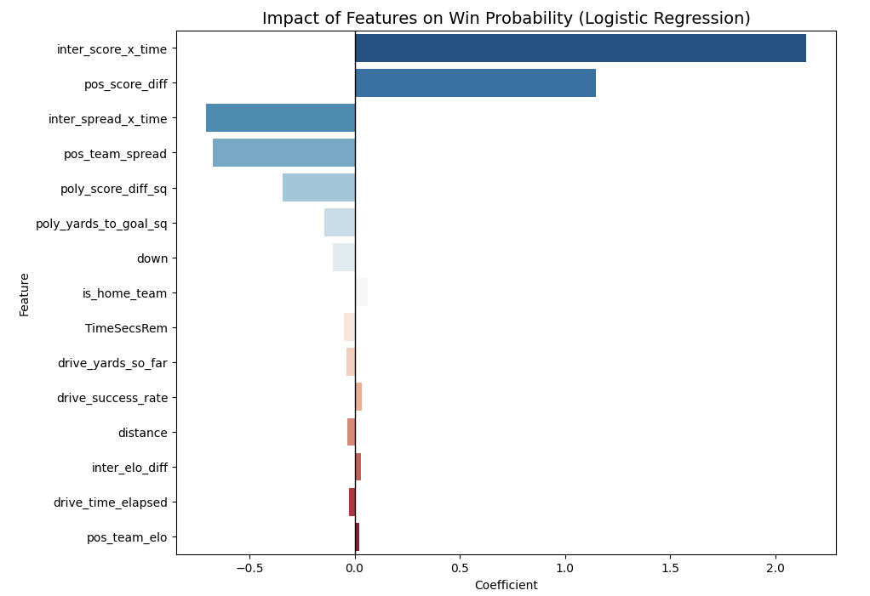
Linear Model (COEFFICIENTS)
Linear model assigns weights to each feature, indicating how strongly they influence the probability of winning
inter_score_x_time : This interaction between score and time remaining is the most important feature, capturing how the impact of a lead changes over the course of a game (Being up 7 early does not equal being up 7 late)
Score differential is a primary driver of win probability, as teams leading the game are more likely to win. Obvious but critical
inter_spread_x_time : This feature combines pre-game expectations with time, allowing the model to adjust predictions based on both team strength and game progression
Model relies heavily on structured interactions between score, time, and team strength.

Slide 22
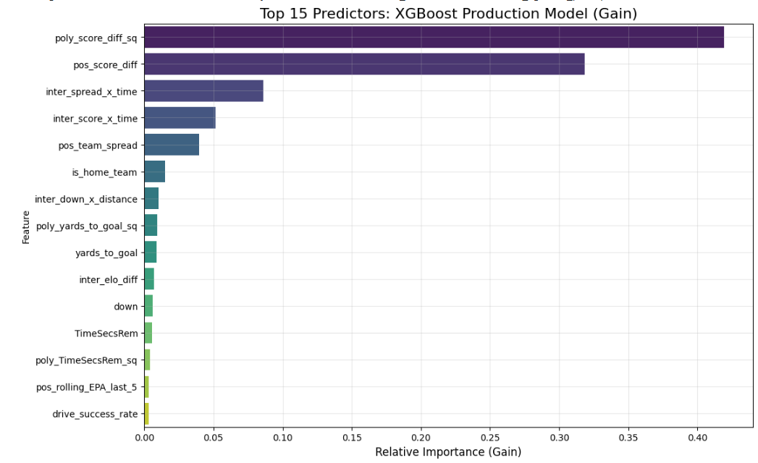
XGBOOST (FEATURE IMPORTANCE)
XGBoost measures feature importance based on how much each feature improves model performance when used in decision trees
poly_score_diff_sq : The squared score differential is the most important feature, highlighting that large leads dramatically increase win probability.
inter_spread_x_time : This feature allows the model to dynamically adjust expectations based on both team strength and time remaining.
inter_score_x_time : This interaction captures how the importance of scoring changes as the game progresses.

Slide 23
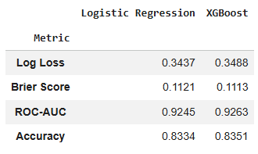
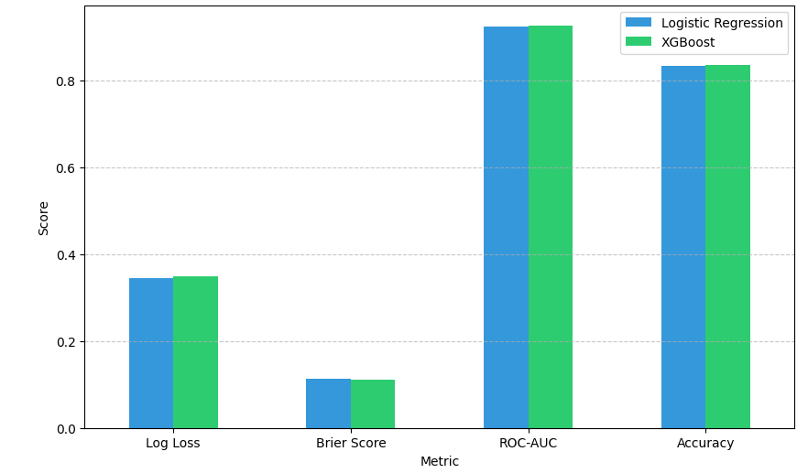
The Takeaway
Across both models, the most important features consistently relate to score, time remaining, and team strength, confirming that win probability is primarily driven by game state.
When a simple Linear model performs nearly as well as a complex Gradient Boosted Trees model, there could be a few explanations as to why:
The Power of Feature Engineering
You can either let the model find relationships (XGBoost) or explicitly tell the model what those relationships are (Feature Engineering). Because we manually created Interactions (Score × Time) and Polynomials (Yards²), we essentially linearized the non-linear physics of football. The Liner model doesn't have to discover those complex relationships anymore
Signal vs. Noise in the Sport
The core features of football (like Down, Distance, Time, and Score) may be extremely strong and consistent. While XGBoost is better at handling edge cases (like rare 4th-down scenarios or massive upsets), the majority games follow a logical, almost linear progression of probability that a linear model can capture.
Diminishing Returns on Complexity
In many cases once you reach an AUC of ~0.92, you have captured almost all the predictable information in the dataset. Moving from 92% to 93% can require 10x the computational complexity (like moving to an LSTM) for only a 1% gain in accuracy.

Slide 24
THE END.

